Slide 1
Diversity Mapping: Indiana University Bloomington
Rona T. Halualani, Ph.D., Managing Principal and Founder
Halualani & Associates

Slide 2
Purpose
Review the diversity mapping process that was undertaken in Summer - Fall 2015
Showcase the diversity maps & our findings about diversity at IU Bloomington
Highlight:
strengths & leverage points
“opportunities” or possible “growth areas

Slide 3
De-Mystifying Your Diversity Habits
“Make Decisions” “Take Strategic Action”

Slide 4
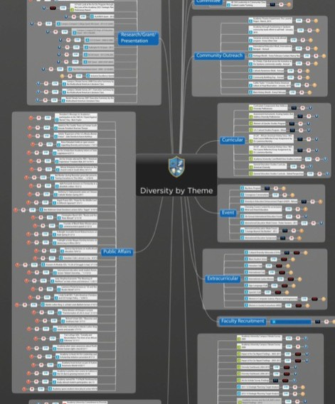
Diversity Mapping
Takes stock of actual eﬀorts
Sets baseline
23 analytical layers
Leverage points
Gaps or “Opportunities”

Slide 5
Mapping Methodology
Web scraping/search engine optimization (SEO)
Info collected from campus divisions
Spreadsheet codings
23 analytical layers
Data analytics applied to all information (“domain analysis” qualitative coding, NVIVO, QDA Miner)
Graphical/visual mapping via Concept Draw
Insights, Gaps, & Leverage Points Analysis

Slide 6
Key Terms for Maps
Diversity Eﬀorts = Campus activities, programs, initiatives, processes, and or events related to diversity, culture, & inclusion

Slide 7
Data Collected
1609 Responses via the Diversity Eﬀorts Informational Survey
Reviewed 483+ documents Submitted Via Dropbox (average of 4 pages per document = 1932 total pages)

Slide 8
Diversity Mapping
Project:
4 Maps
Diversity Eﬀorts By Unit (1)
Diversity Eﬀorts By Theme (1)
Diversity-Related Events (1)
Diversity-Related Student Organizations (1)

Slide 9
Doing the “Work” of
Diversity

Slide 10
Is Indiana University Bloomington
Actively Creating an Inclusive & Diversity-Excellence Culture?

Slide 11
Yes . . .
In Part
1966
Diversity Eﬀorts

Slide 12
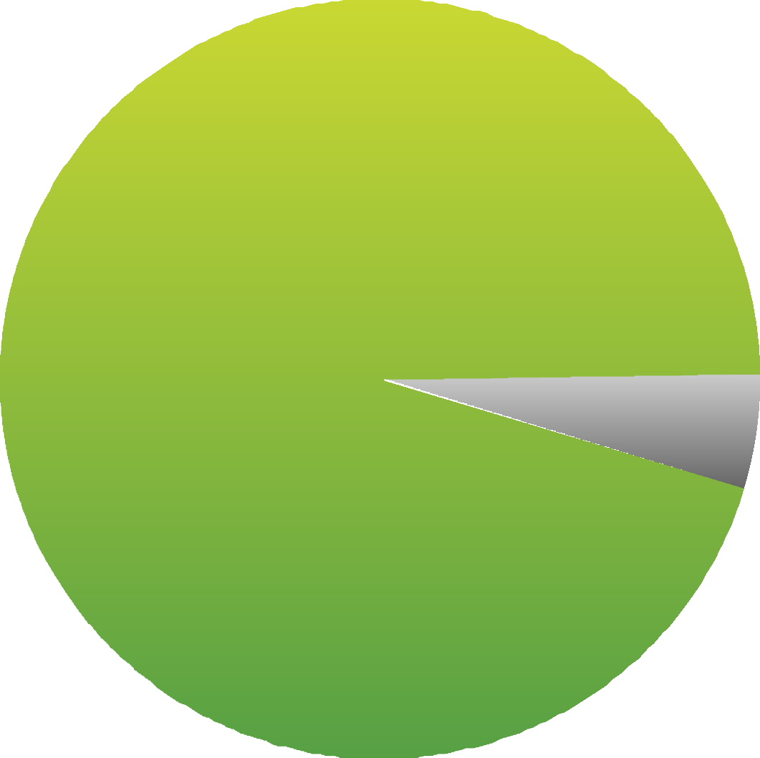
IU Bloomington’s Diversity Actions
Level of Commitment to Diversity
Predominantly engaging in action that centrally focuses on diversity
Eﬀorts’ Levels of Focus (All)
Primary (1869)
95%
Partial (97)
5%

Slide 13
IU Bloomington’s Diversity Actions
All Divisions Mostly On Deck
503
Collaborations
= 26% of all eﬀorts (Impressive)
Average of 3 units/programs working together on any eﬀort
Eﬀorts (All) - Division
Faculty & Academic Aﬀairs (870)
44%
Oﬃce of Provost, IU Bloomington (796)
40%
Oﬃce of President, Indiana University (297)
15%
Oﬃce of the Treasurer, Indiana University (2) 0%
Board of Trustees (1)
0%
0%
13%
25%
38%
50%

Slide 14
IU Bloomington’s Diversity Actions
Primary Eﬀorts Focused On 4 Main Definitions of Culture
International/ Global & Race/ Ethnicity, Gender, Broad Culture
Level of Focus - Definition of Culture (All)
Broad Culture/Diversity
73%
27%
Race/Ethnicity
95%
5%
International/Global
97%
3%
Gender
92%
8%
0%
25%
50%
75%
100%
Primary Eﬀorts Partial Eﬀorts Integrated Eﬀorts

Slide 15
ASSESSING THE EVOLUTION OF A DIVERSITY PRACTICE
H & A has developed a* unique numbering sequencing designation that indicates the degree of /0.a0!#%c evolution of a diversity effort/ practice in terms of the following:
1
2
3
4
First order -
Declarative efforts Ē ,+(%c%!/ 0$a0 !/0ab(%/$ a commitment to diversity.
Second order -
Commitment is demonstrated by an action, effort, or program.
Third order -
Sustained action %/ a*c$+.! 0+ a /0.a0!#%c ".a)!3+.'. E2% !*0
,+/%0%2! %),ac0 )1/0 b! )a !ċ
Fourth order - Transformative & culture changing practices. S1/0a%*! Č ,.%+.%0%6! ac0%+*/ 3%0$ )a&+. ,+/%0%2!
%),ac0ċ S0a* / a/ "1((5 .!/+1.c! a* %*/0%010%+*ġ3% !ċ
* These categories remake the notion of “business as usual.”
* The goal is to have a ba(a*c! a* Ŏb1%( %*#Ŏ .!,.!/!*0a0%+* +" %2!./%05
!""+.0/ ac.+// a(( c$a*#! +. !./ċ

Slide 16
IU Bloomington’s Diversity Actions
Overall Change Order Stage
At what stage is your campus toward diversity excellence?
Action Stage - 2nd Order
Between action & impact assessment
Need more traction in strategic priority mode
Diversity Change Order Sequence (All)
1% 99%
0%
25%
50%
75%
100%
1st Order (16) 3rd Order
2nd Order (1950) 4th Order

Slide 17
IU Bloomington’s Diversity Actions
Overall Change Order Stage
All main divisions in action stage
Academic colleges & departments = engaged
Division - Change Order (All)
Oﬃce of President, Indiana University | 2% |  |  | 98%
Oﬃce of Provost, IU Bloomington | 1% |  |  | 99%
Faculty & Academic Aﬀairs |  |  |  | 100%
Oﬃce of the Treasurer, Indiana University |  |  |  | 100%
0%
25% 50%
1st Order 3rd Order
75%
2nd Order 4th Order
100%

Slide 18
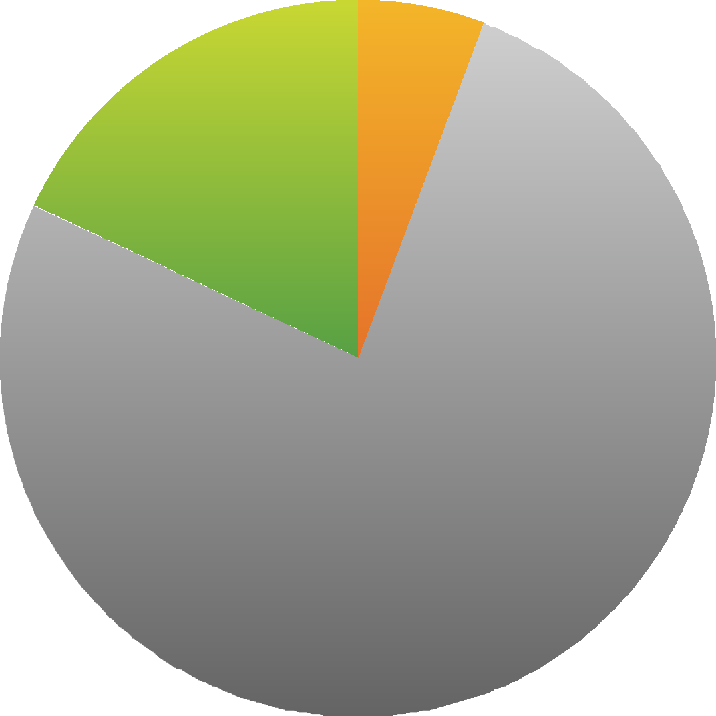
IU Bloomington’s Diversity Actions
How aligned are your divisions towards a shared framework of diversity excellence?
Eﬀorts initiated by programs & units
Cost-Sharing?
More Strategic Focus/ Alignment via IUB Campus Strategic Plan & IU Strategic Plan
Eﬀorts (All) - Initiation Point
University-Wide (112)
6%
Student-Initiated (354)
18%
Program-Driven (1500)
76%

Slide 19
IU Bloomington’s Diversity Actions
Diﬀerent foci on diversity in diﬀerent divisions
Oﬃce of President involved in all types
Oﬃce of Provost taking lead in Inclusion & Social Justice
Diversity Represented (All) - Division
Active Diversity
17%
29%
54%
Inclusion 10%
68%
22%
Comp. Diversity
100%
Social Justice
18%
76%
6%
0%
25% 50% 75%
Oﬃce of President, Indiana University Oﬃce of Provost, IU Bloomington Faculty & Academic Aﬀairs
Oﬃce of the Treasurer, Indiana University
100%

Slide 20
IU Bloomington’s Diversity Actions
Motivational Sources (All)
Intrinsically motivated
Intrinsic/Proactive (1946)
99%
Compliance & Crisis Do Not Overshadow IU Bloomington’s Diversity Eﬀorts
Extrinsic/Compliance (20) 1%
Extrinsic/Crisis/Reactive
0%
0%
25%
50%
75%
100%

Slide 21
Leverage Points
Significant Amount of Recurring Diversity Eﬀorts = Institutionalization of Diversity Focus
Diversity Eﬀorts (All) by Year
1200
460
1050
900
207
750
244
288
Single Year Eﬀorts All Years Eﬀorts
198
151
674
674
673
672
673
672
600
450
300
150
0
2010
2011
2012
2013
2014
2015

Slide 22
Clarifying a Diversity
Vision
Primary Focus Mostly in 2nd Order Action Active Diversity & Inclusion
Intrinsically Motivated
But What Is The Larger Diversity Vision/End Goal?
Need to Clarify & Operationalize Diversity Vision via Action Steps

Slide 23
Identify the Diversity
Endgoal
Indicates an abundance of addressing diversity through multiple forms; Will pare down based on strategic priority
process
Eﬀorts - Theme (All)
Event (1153)
Student Club/Organization (296)
Student Recruitment (110)
Campus Resource (80) 4%
Financial Aid/Scholarship (53) 3%
Training/Workshop (47) 2%
Faculty Recruitment/Retention (30) 2%
Student Retention-Graduation Initiative (24) 1%
Grant (21) 1%
Role (19) 1%
Committee (17) 1%
Institutional Research (17) 1%
Award (14) 1%
Mission Statement (14) 1%
Co-Curricular (12) 1%
Academic Program Support (9) 0%
Directive/Policy (9) 0%
Strategic Plan (9) 0%
Campus Climate (7) 0%
Community Outreach/Partnership (6) 0%
Fundraising (5) 0%
Diversity Infrastructure (4) 0%
Curricular (3) 0%
Special Initiative (3) 0%
Public Aﬀairs (2) 0%
Extracurricular (1) 0%
Staﬀ Recruitment/Retention (1) 0%
59%
6%
15%
0%
15%
30%
45%
60%

Slide 24
Action Step/ Recommendations
*Diversity Strategic Priority Process
*Use the IU Bloomington Campus Strategic Plan to Identify the Priorities
*Elaborate on the Vision
*Operationalize the Vision via Action Steps
*Approach to Diversity

Slide 25
Action Step/ Recommendations
*Diversity Strategic Priority Process
2014 Established Objectives:
*Internationalization Focus
*Inclusive Pedagogies for STEM
*Diversify Graduate Students
*Recruit & Retain Diverse Faculty
*Culture of Care

Slide 26
Action Step/ Recommendations
*Diversity Strategic Priority Process
Goal Areas To Consider:
*Inclusion & Belonging
*Diversity Engagement (In & Out of the Classroom)
*Diverse Retention & Graduation (Retention Structures for Specific Groups)

Slide 27
Action Step/ Recommendations
*Campus Climate (Experiences) Assessment Every Two Years
*Departure Study
*Examine the Integration of Diversity Content, Topics, Pedagogies in All Curricula (UG, GR)

Slide 28
Action Step/ Recommendations
*Campus Climate (Experiences) Assessment Every Two Years
*Departure Study
*Examine the Integration of Diversity Content, Topics, Pedagogies in All Curricula (UG, GR)

Slide 29
Identify the Diversity
Endgoal
Eﬀorts mostly define diversity in terms of:
Race/Ethnicity
Gender
International/ Global
Intersectionalities
Need to engage the following more: Disability, Political Ideology, Veterans
Definitions of Diversity in Eﬀorts (All)
24%
Race/Ethnicity (1682)
Gender (961)
14%
International/Global (889) |  |  | 13%
Intersectionalities (863) |  |  | 12%
Nationality (850) Socioeconomic Status (656) |  | 9% | 12%
Language (606) |  | 9%
Age (154) | 2%
Religion (123) 2%
Sexual Orientation (117) 2%
Broad Culture/Diversity (95) 1%
Disability (60) | 1%
Political Ideology (25) | 0%
Active Duty/Veterans (24) | 0%
Region (6) | 0%
Generation | 0%
0%
8%
15%
23%
30%

Slide 30
Identify the Diversity
Endgoal
Steady Focus on Race/Ethnicity, International/Global
Diversity Eﬀorts (All) By Key Definitions of Culture - 2010 - 2015
1100
24
127
18
94
64
279
825 ₂₄
76
62
251
22
89
17
76
64
228
25
86
Sexual Orientation Gender
Religion International/Global Race/Ethnicity
Broad Culture/Diversity
64
225
60
251
67
223
550
473
390
319
317
335
292
275
₀ 44
45
45
54
64
59
2010
2011
2012
2013
2014
2015

Slide 31
Action Step/ Recommendations
*Engage Diversity in All of its Richness, Complexities, & Tensions
*Transgender, Socioeconomic Class, Sexual Orientation, Political Ideology, Intersectionalities

Slide 32
Make Decisions About Your
Diversity Eﬀorts
Specific divisions focus on specific types of eﬀorts
Oﬃce of Provost, IU Bloomington Oﬃce of President, Indiana University Faculty & Academic Aﬀairs
Oﬃce of the Treasurer, Indiana University
Theme - Division
Event
29%
15%
56%
Training/Workshop
30%
38%
32%
Student Club/Organization
100%
Campus Resource
43%
13%
43% 3%
0%
25%
50%
75%
100%

Slide 33
Make Decisions About Your
Diversity Eﬀorts
Eﬀorts mostly expose/inform, support, recruit, & include
Eﬀort Function (All)
EXPOSE/INFORM (1171)
SUPPORT (333)
RECRUIT (142)
INCLUDE (60) 3%
DEVELOP (48) 2%
SERVE (46) 2%
PLAN (35) 2%
RETAIN (34) 2%
CONNECT (30) 2%
RECOGNIZE (22) 1%
MONITOR/ACCOUNT FOR (21) 1%
PROTECT (19) 1%
REFLECT (5) 0%
ADVOCATE 0%
INFORM 0%
60%
17%
7%
0%
15%
30%
45%
60%

Slide 34
Action Step/ Recommendations
*Determine the Impact of Diversity Eﬀorts (What are these eﬀorts achieving or not achieving?)
*Impact/Assessment Protocols
*Build into Diversity Strategic Priority Process

Slide 35
Identify the Diversity
Endgoal
Clubs/Organizations - Are There Enough Support Mechanisms for Culturally Diﬀerent Students?
Student Organization Themes
Political/Social Awareness/Volunteer/Service (61)
Religious/Spiritual (42) Identity-Based & Academic (39) Identity-Based (International) (33) Academic & Professional (29) Identity-Based (Domestic) (29)
Common/Special Interest/Social (24) Fraternities & Sororities (19) Performance/Media (12)
Diversity/Multicultural (8)
Governance Sports & Recreation
21%
14%
13%
11%
10%
10%
8%
6%
4%
3%
0%
0%
0%
8%
15%
23%
30%

Slide 36
Identify the Diversity
Endgoal
Clubs/Organizations - Are There Enough Support Mechanisms for Culturally Diﬀerent Students?
Clubs/Organizations - Primary Definition of Diversity
International/Global (90) |  |  |  |  | 32%
Race/Ethnicity (57) |  |  | 20%
Religion (54) |  |  | 19%
Gender (18) | 6%
Political Ideology (16) | 6%
Nationality (13) | 5%
Language (9) | 3%
Broad Culture/Diversity (8) | 3%
Socioeconomic Status (7) | 2%
Disability (6) | 2%
Active Duty/Veterans (3) | 1%
All Intersectionalities | 0%
 | 0% | 10% | 20% | 30% |  | 40%

Slide 37
Identify the Diversity
Endgoal
Identity-Based Clubs/Organizations = Leverage These Vehicles for Inclusion, Belonging, Climate; More Initiatives Here
Identity-Based & Academic Student Orgs By Definition of Diversity
Race/Ethnicity (20)
32%
Gender (19)
31%
Intersectionalities (19)
31%
International/Global (3)
5%
Sexual Orientation (1)
2%
0%
10%
20%
30%
40%

Slide 38
Make Decisions About Your
Diversity Eﬀorts
Current eﬀorts intended for “all” but not diﬀerentiated for specific segments
Eﬀorts - Target Population (All)
All Campus Members (1134)
58%
All Students (459) |  |  | 23%
Undergraduate Students (191) |  | 10%
Graduate Students (97) | 5%
Faculty (49) | 2%
Employees (Incl. Faculty & Staﬀ) (21) | 1%
Community Members (13) | 1%
Staﬀ (1) | 0%
Administrators (1) | 0%
Faculty/Staﬀ/ Employees Not Fully Reached
0%
15%
30%
45%
60%

Slide 39
Action Step/ Recommendations
*Create Targeted Diversity Eﬀorts for Faculty Members, Staﬀ Members, Administrators, Community Members

Slide 40
Diversity Engagement & Learning Taxonomy (DELTA)
(Halualani, Haiker, & Lancaster, 2012)
Level 7 - Innovative Problem Solving
Innovative thinking
Uses multiple perspectives to develop new, original, unique, impactful strategies & solutions to problematics
Relies on multiple heuristics (from all cultures, contexts, arenas of life)
All diversity-related events were examined in terms of our Diversity Engagement Learning Taxonomy Assessment (DELTA).
Level 6 - Social Agency & Action
Designing Actions, Personal-Social Responsibility Able to see connections across differences Problem-solving, Responsive decision making Constructive-Resistive (from the marginalized side) Action, Advocacy, Allies,
Sharing with/Teaching Others
Level 5 - Evaluation-Critique
Evaluation/Critique of Power Differences, Positionality/ Compassion
Posing Complex Questions
Engagement
Level 4 - Advanced Analysis
Higher
Perspective-Taking/ Reflection/ Analysis, Self-Other Dynamic Personally invested in diversity
Unscripted/Off the Beaten Path
Free-flying among concepts, areas to ferret out the big, difficult questions and major problematics, stakes, urgencies
Level 3 - Interaction
Active Involvement in Intercultural Interactions Motivation, Seeking Out, Participating Behavior
Engagement
Level 2 - Skills
Application/Intercultural Competence/Skills-based
Lower
Level 1 - Knowledge-Awareness
Knowledge, Awareness, Appreciation Touches on Social Approvability Level

Slide 41
Make Decisions About Your
Diversity Eﬀorts
Events = Mid-Levels of DELTA (Diversity Engagement/ Learning)
Focuses On Advanced Analysis or Critical Evaluation & Beyond
Leverage Points
Target engagement levels for events &/ or life-stage these.
Events - DELTA
1-Knowledge Awareness (134)
12%
2-Skills (3) 0%
3-Interaction (37)
3%
4-Adv. Analysis (707)
61%
5-Evaluation-Critique (269)
23%
6-Social Agency & Action (3) 0%
7-Innov. & Prob. Solving
0%
0%
18%
35%
53%
70%

Slide 42
Make Decisions About Your
Diversity Eﬀorts
Events = Focus on Race/ Ethnicity, International/ Global, Various Aspects
Focus more on Disability, Veterans, Political Ideology, Generation
Definitions of Diversity in Events
Race/Ethnicity (1083)
International/Global (687)
Nationality (648)
Language (574)
24%
15%
15%
13%
Gender (469) |  |  | 11%
Intersectionalities (465) Socioeconomic Status (342) |  | 8% | 10%
Sexual Orientation (73) | 2%
Religion (65) | 1%
Broad Culture/Diversity (20) 0%
Disability (15) 0%
Age (12) 0%
Active Duty/Veterans (6) 0%
Political Ideology (5) 0%
Region (2) 0%
Generation 0%
0%
8%
15%
23%
30%

Slide 43
Make Decisions About Your
Diversity Eﬀorts
One-Time = Various Definitions; Recurring Events = More on
Religion, SES
One-Time Recurring
Recurring Vs. One-Time Events - Definition of Culture
90% 88% 98% 100% 97% 50%
100%
95%
84%
33%
100%
75%
67%
50%
50%
25%
16%
13%
10%
0%
5%
2%
3%
Brd. Culture R/E
Gender
Disability Sex. Ortn.
Lang.
Interntl.
SES
Relign. Pol. Ideology

Slide 44
Action Step/ Recommendations
*Integrate Events into Academic Learning via a Passport Program
*Events Aligned to SLOs in a Course, To an Assignment, & Assessed
*Powerful Curricular-Co-Curricular Initiative

Slide 45
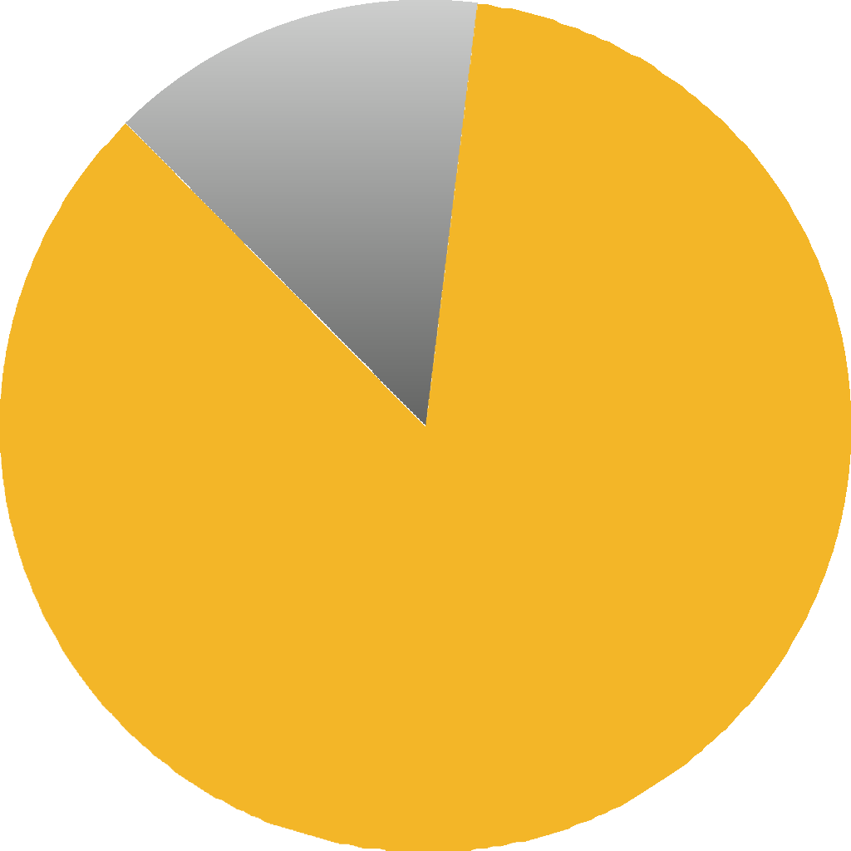
Make Decisions About Your
Diversity Eﬀorts
Eﬀorts for mainstream & diﬀerentiated groups
Diﬀerentiated groups
= Race/Ethnicity
Ample Range of Academic Support Services, Clubs, Events & Group-Specific Retention-Graduation Initiatives
Eﬀorts By Topical Focus (All)
Mainstream (283)
14%
Specific Group Focused (1683) 86%

Slide 46
Action Step/ Recommendations
*Continue to Develop Specific-Group Focused Retention-Graduation Initiatives
*Overall Graduation Rate = 77% (2008 cohort for full-time beginners
*Latino (67%)
*African Americans (61%)
*URM/Diverse Students

Slide 47
Make Decisions About Your
Diversity Eﬀorts
Recruit Eﬀorts - Solid for Undergraduate Students & Graduate Students
Recruit Function - Target Population
4%
100%
15%
Administrators Staﬀ
Community Members
Faculty
Graduate Students Undergraduate Students Employees
All Students
All Campus Members
75%
18%
Not as much as expected for Faculty or Staﬀ
50%
61%
25%
0%
2¹%

Slide 48
Action Step/ Recommendations
*Push Forward With Its Diversifying Faculty Initiative & Eﬀorts
*Explore Creative Strategies
*Firmly Resolute & Steadfast!

Slide 49
Limited Guarantee of
Continued Action
Diversity eﬀorts are not stable/institutionalized
Actions framed for the short-term
Enduring Factor (All)
1 = Immediate, short-term (1057)
54%
2 = The next 1-2 years (308)
16%
3 = The next diversity strategy cycle (590)
30%
4 = Transcending (11) 1%
0%
15%
30%
45%
60%

Slide 50
Questions and/or Comments?

